Slide 1
Redefining NBA Positions -Clustering Analysis based on Player Shooting Style
Xudong Liang (Brandon)
Davidson College ‘2017

Slide 2
About me
Xudong Liang, Brandon
Davidson College ‘2017
Math Major, Computer Science Minor
Basketball
Charlotte Hornets
Sports and Data Analytics

Slide 3
Inspiration
Myth of “Position”
Height/Size vs Position
PG or SG: Allen Iverson
SG vs SF?
PF: Draymond Green over David Lee
NBA Going Small
Evolution of Basketball Positioning
The traditional 5-position categorization can no longer suffice the evolving dynamics of the NBA, especially in terms of shooting.

Slide 4
Works Done By Others
<Redefining NBA Positions> @MIT Sloan Conference
Muthu Alagappan
https://flowingdata.com/2012/03/21/redefining-nba-basketball-positions/
“But what if we were wrong about our initial five positions. Maybe a Center is just a label for people over a certain height, and there are actually 3 types of big men in the NBA.”

Slide 5
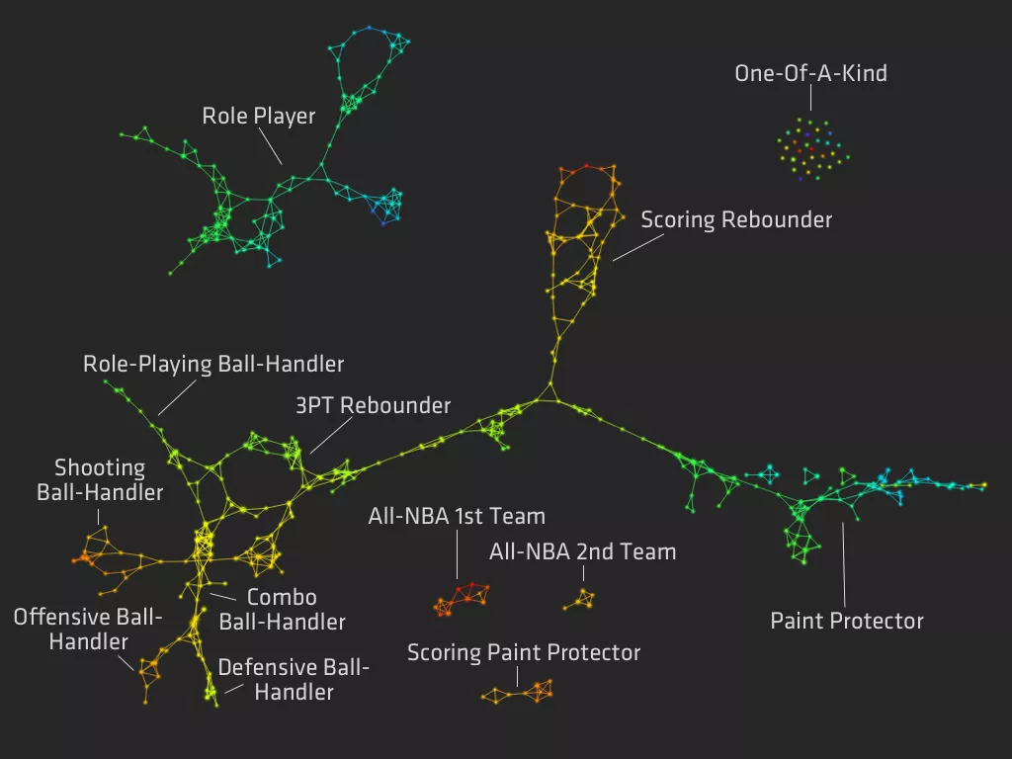

Slide 6
Brain Storm
Goal:
A more detailed categorization-clustering for players
My Thoughts:
Cluster within “Position”
Fundamental Differences between “Positions”
“Boundary” between “Positions”
Focus: Shooting
Care about: How each player plays/shoots
Not care about: How well each player plays/shoots
Nutshell: Shooting Style
Adjusted Goal:
Clustering players within each “Position” based on Shooting Style
Notes:
Explore the Boundary
FGA
Not FG or FG%

Slide 7
Methodology
Breaking Down each Player’s Shot Distribution by Range:
0 to 12 feet: Paint
12 to 24 feet: Mid-Range
24 feet and beyond: 3 Pointer (22 Feet actually)*
Feature

Slide 8
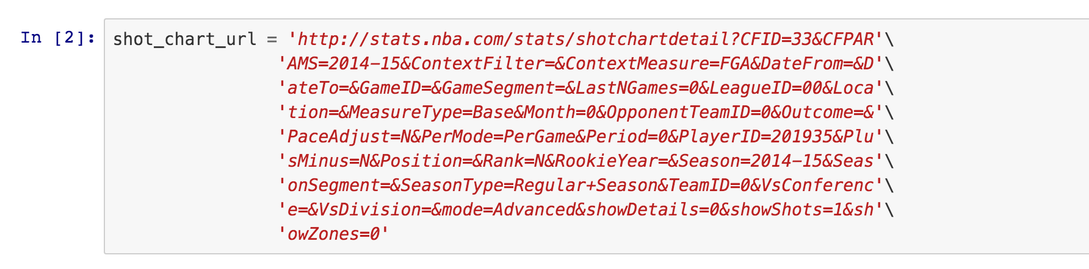
Data
<How to Create NBA Shot Chart in Python>
By Savvas Tjortjoglou

Slide 9
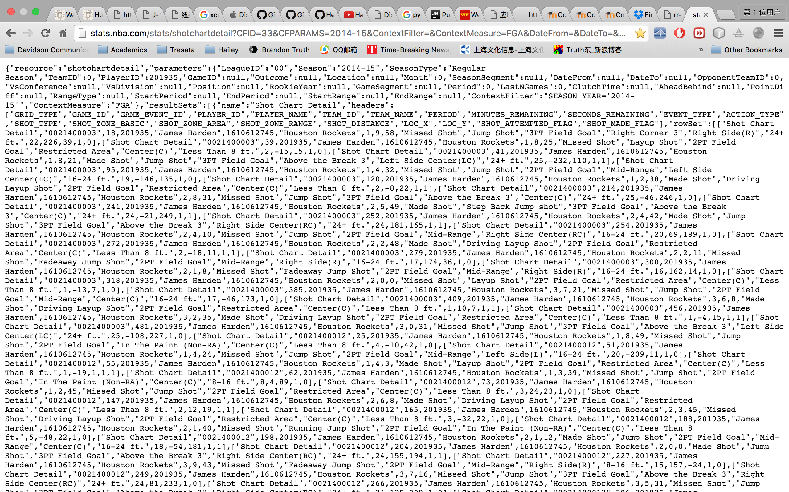

Slide 10
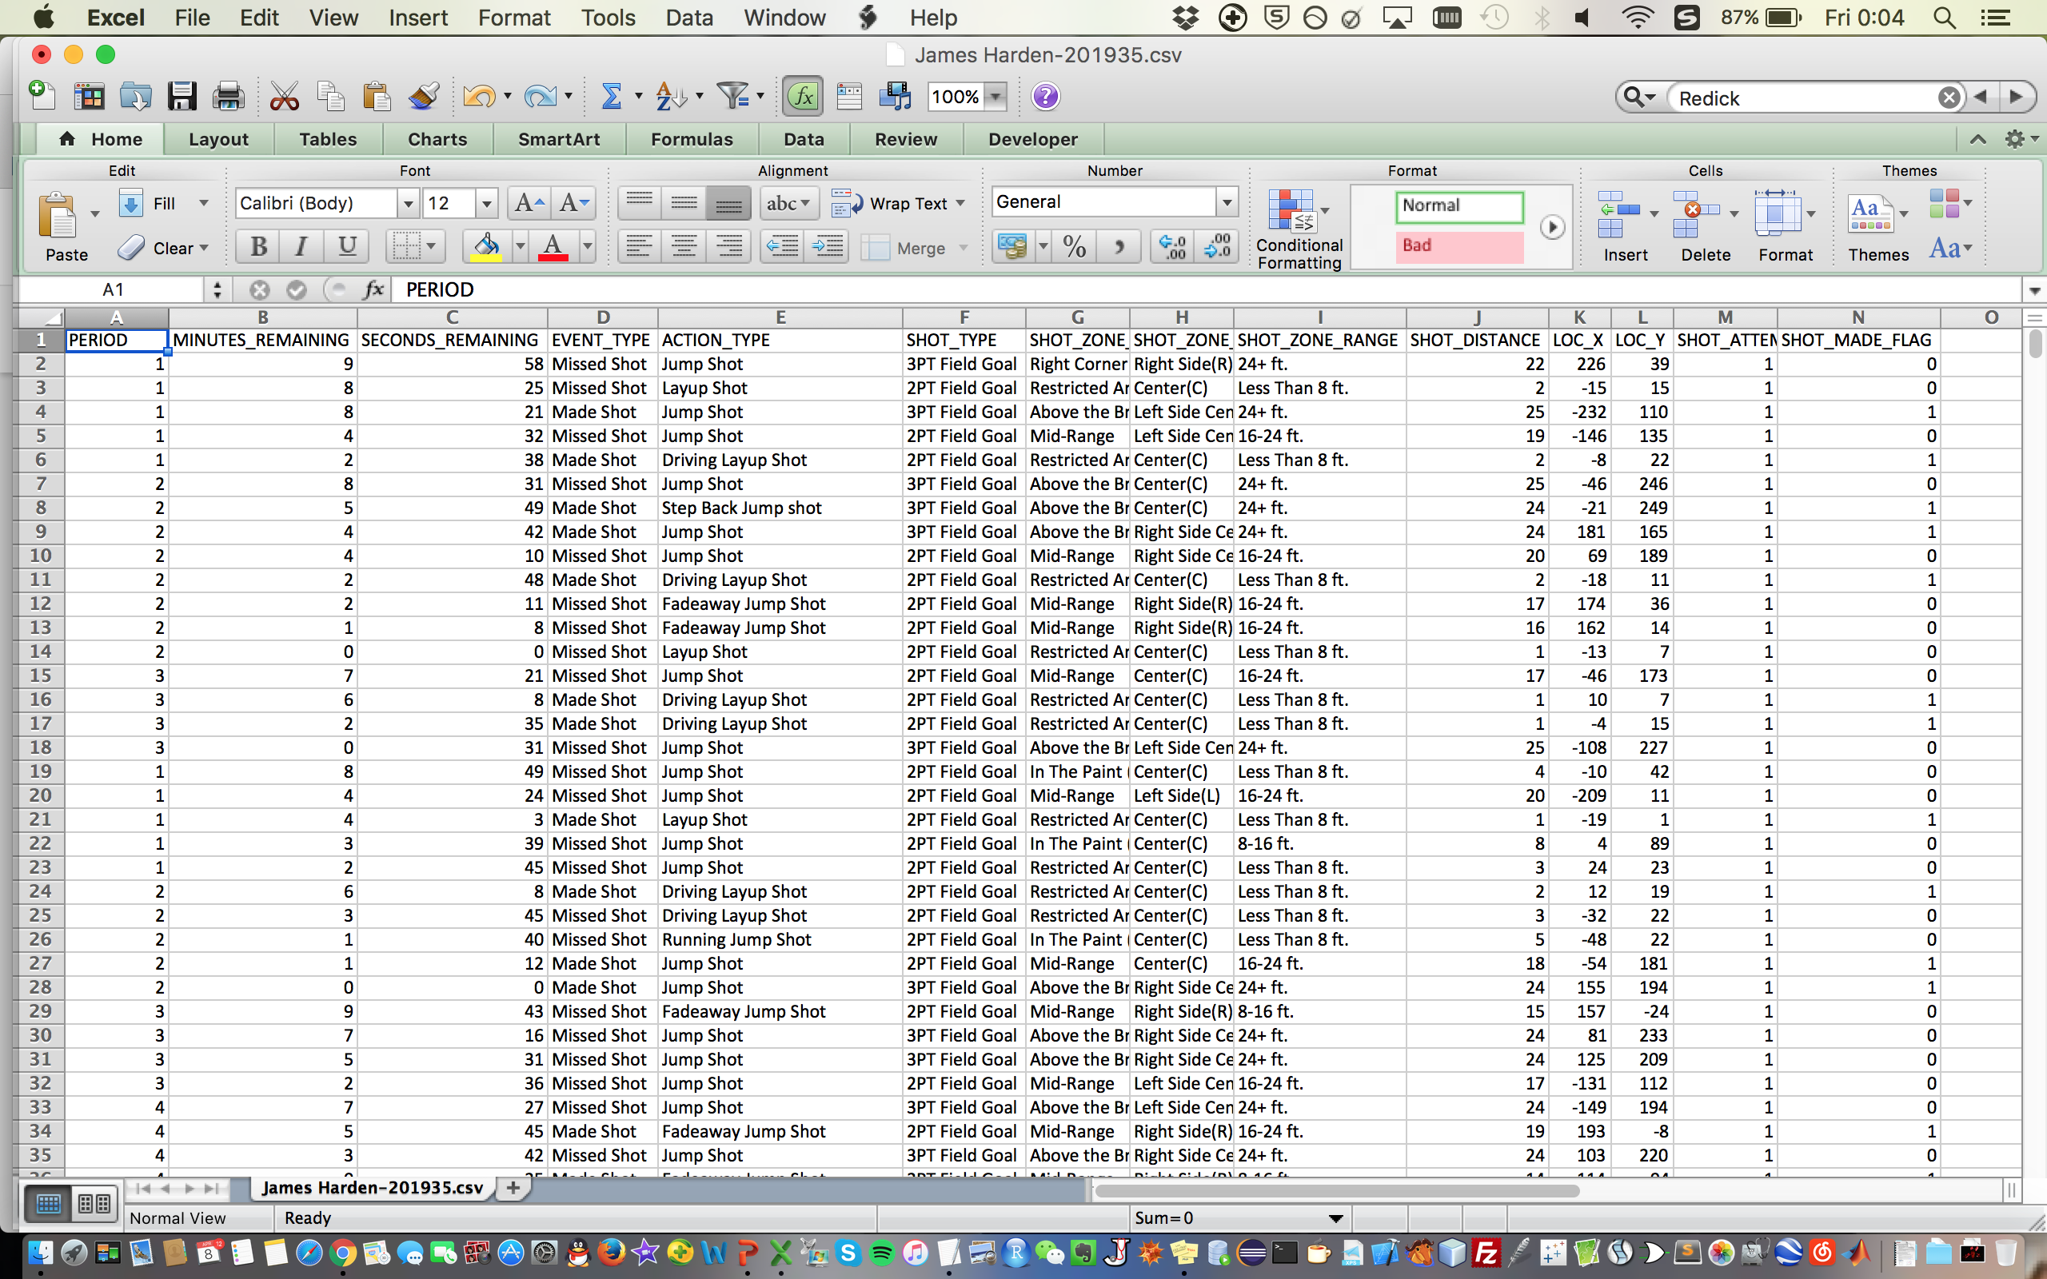

Slide 11
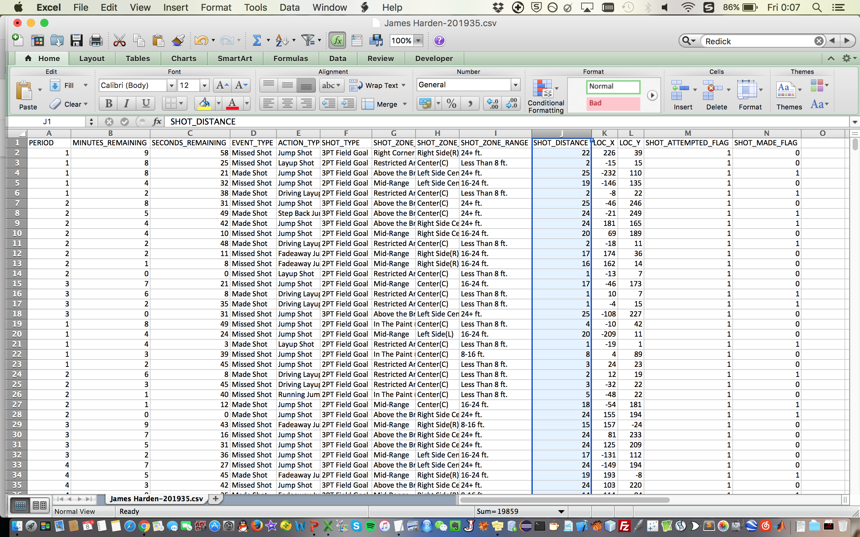

Slide 12
Data

Slide 13
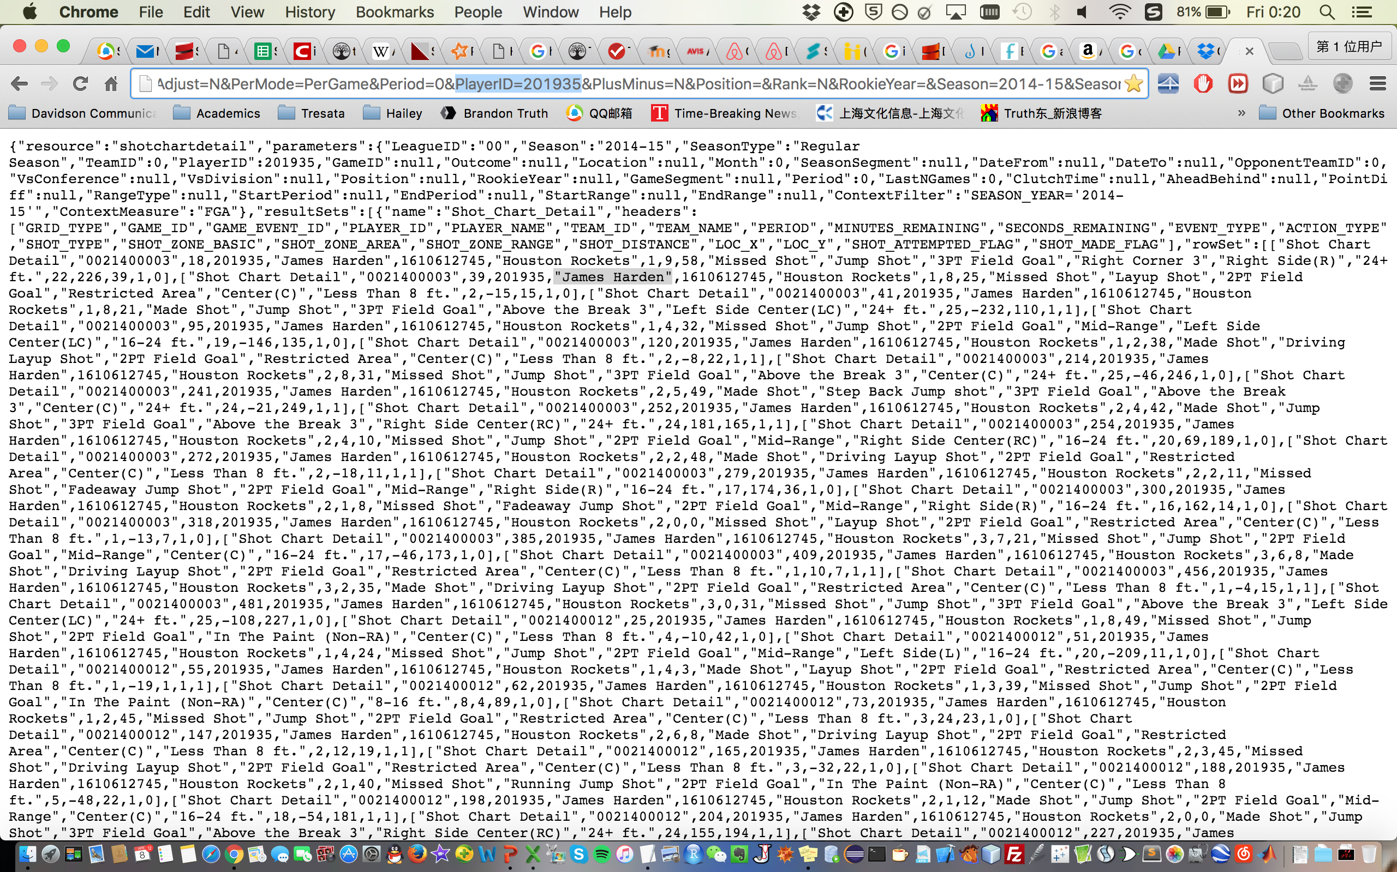
Data (More..)

Slide 14
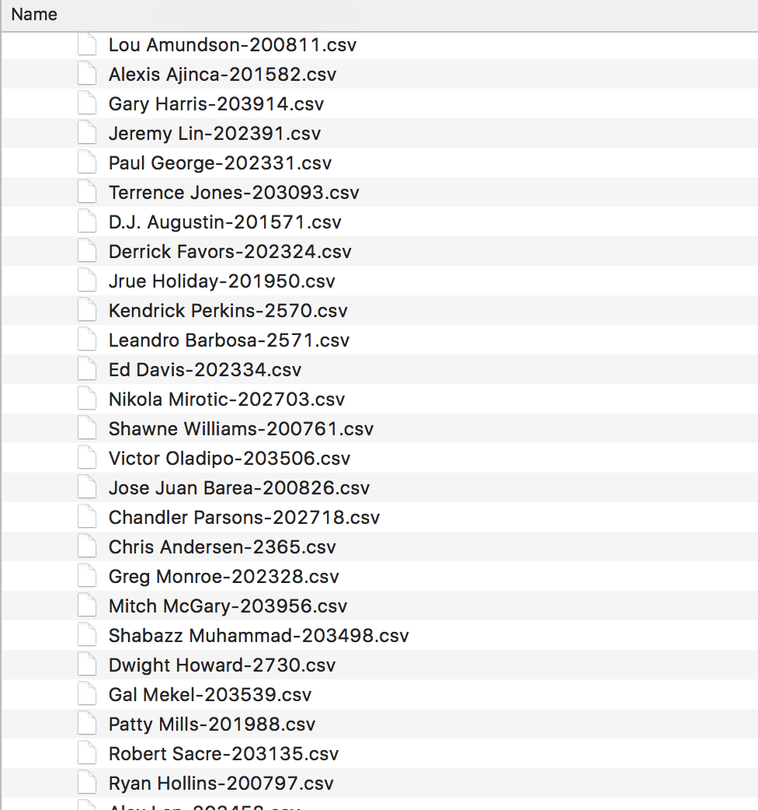

Slide 15
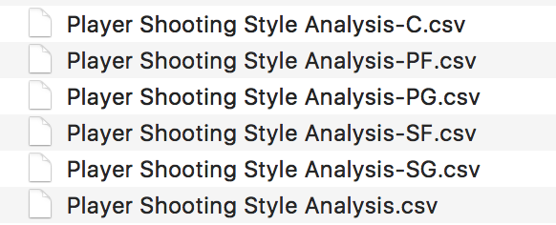
Data

Slide 16
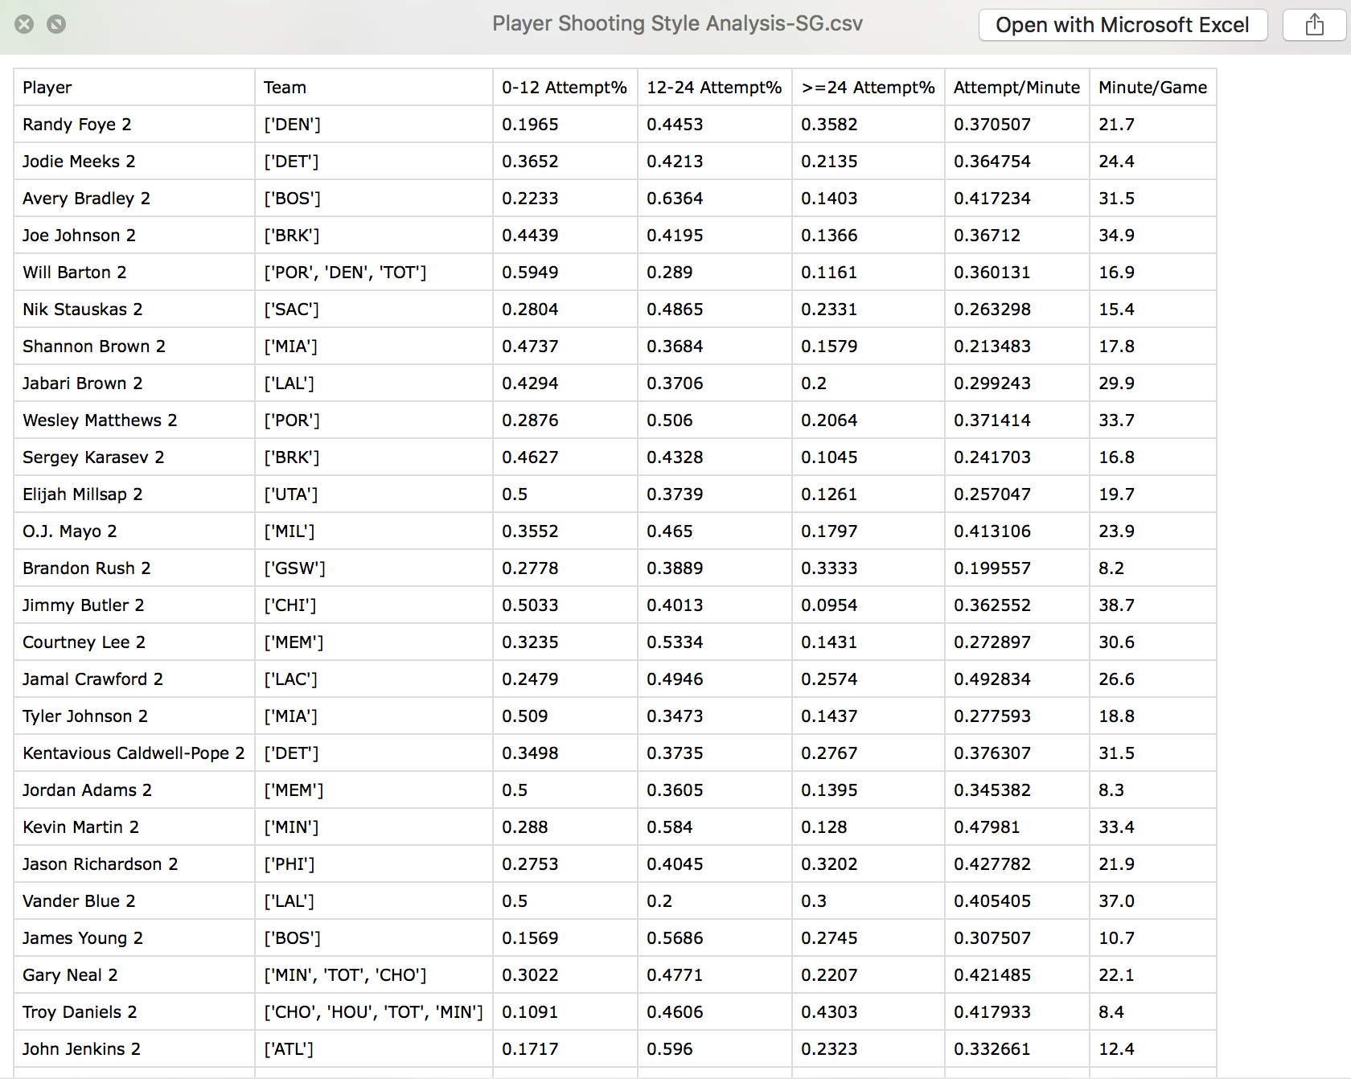

Slide 17
Data Limitations
Missing Data due to “Player ID”
Kobe Bryant, Tim Duncan, etc.
Data only indicative of
2014-2015 Season
players’ shooting style-Field Goal Attempt

Slide 18
Clustering
Definition
Grouping a set of objects in such a way that objects in the same group (cluster) are more similar to each other than to those in other groups (clusters)
A set of objects: Players within each “Position”
Group/Cluster: What we want
“Similar”:
Intuitively: Shoots similarly Over Each of the 3 Ranges
Mathematically: Euclidean Distance

Slide 19
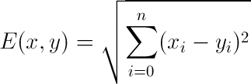
Euclidean Distance
x,y: Any Pair of Data Points (Players)
xi, yi: Features
Features: 3 Percentages of Shot Distribution
n = 3
Euclidean Distance:
Measures the “closeness” between two data points based on their features
Similarity of Players’ Shooting Styles

Slide 20
Unsupervised Clustering
Python’s Scikit Library: sklearn.Cluster.Kmeans
K = 8 for each position
My Arbitrary Choice
Got 8 Clusters/Groups within each “Position”
Outlier Cluster
Manual Combination of Clusters

Slide 21
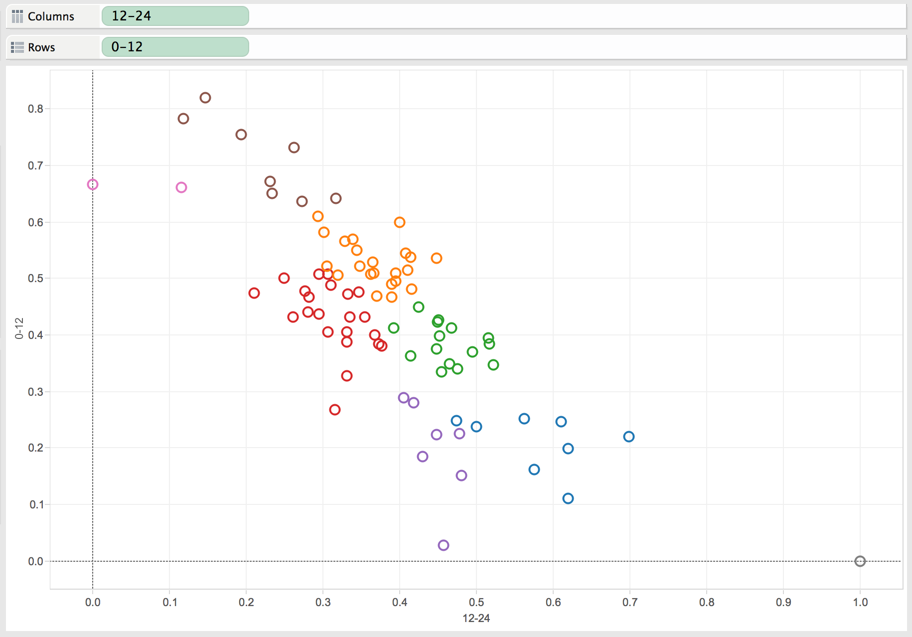
Illustration

Slide 22
Result
Point Guard: 8 Clusters (1 Outlier Cluster)
Shooting Guard: 7 Clusters (1 Outlier Cluster, 1 Special Cluster)
Small Forward: 6 Clusters
Power Forward: 7 Clusters
Center: 7 Clusters

Slide 23
Point Guard
Cluster | 0-12 % | 12-24 % | >24 % | Count | All-Star | Interpretation | Key Players
0 | 0.2170 | 0.5779 | 0.2051 | 9 | 1 | Mid-Range, >55% | Chris Paul
1 | 0.5279 | 0.3685 | 0.1036 | 22 | 1 | Attacking, Paint (less) descending order, occasional 3 | Tony Parker, Russell Westbrook
2* | 0.3853 | 0.4627 | 0.1520 | 15 | 1 | Balanced inside 3 | John Wall
3* | 0.4319 | 0.3120 | 0.2561 | 22 | 4 | Balanced throughout! — All-Star Caliber | Curry, Lowry, Lillard, Irving
4 | 0.1977 | 0.4453 | 0.3570 | 7 | 0 | Mid-Range >40%, 3 Pointer | Brian Roberts
5 | 0.7110 | 0.2216 | 0.0674 | 8 | 0 | Attacking, Paint (more) descending order, barely 3 | Shaun Livingston
6 | 0.6640 | 0.0576 | 0.2784 | 2 | 0 | Paint (more) or 3, Barely Mid-Range | Tony Wroten
7 | 0.0000 | 1.0000 | 0.0000 | 2 | 0 | Mid-Range--Outlier, small sample size of shots | Seth Curry
Mean | 0.4281 | 0.3922 | 0.1797 | Closest Cluster: | 2,then 3
StdDev | 0.1659 | 0.1497 | 0.1023
Notes:
0-Ricky Rubio?
1-Jimmer Fredette?
3-Rose? Future All Stars: Kemba, Isaiah
4-Mostly Backup PG
6-PG Both Released Outlier

Slide 24
Notes:
Most populated clusters tend to have steady production of all stars. Cluster 3 especially—point guard who shoot evenly over all 3 ranges of the floor

Slide 25
Shooting Guard
Cluster | 0-12 % | 12-24 % | >24 % | Count | All-Star | Interpretation | Key Players
0 | 0.1220 | 0.5030 | 0.3750 | 6 | 1 | Jump shooter (Mid-Range and 3, Balanced, Barely Paint) | J.R Smith, Kyle Korver
1 | 0.5801 | 0.2957 | 0.1241 | 21 | 0 | Attacking, In the paint | Andrew Wiggins, Victor Oladipo
2* | 0.4544 | 0.4555 | 0.0901 | 13 | 3 | Balanced inside 3 (Barely 3) -- All-Star Caliber | Wade, DeRozan, Butler
3 | 0.0000 | 0.0000 | 1.0000 | 1 | 0 | Outlier: Small Sample/Shot Size | Jamaal Franklin
4* | 0.3637 | 0.3979 | 0.2384 | 23 | 2 | Balanced, --All-Star Caliber | James Harden, Klay Thompson
5 | 0.2704 | 0.5332 | 0.1964 | 28 | 0 | Mid-Range (=50%) | Jamal Crawford, Danny Green, Beal
6 | 0.9341 | 0.0572 | 0.0088 | 2 | 0 | Tony-Allen Special | Tony Allen, Malcom Lee
Mean | 0.3897 | 0.4186 | 0.1918 | Closest Cluster: | 4, then 2
StdDev | 0.1709 | 0.1251 | 0.1240
Notes:
1-Age:Young
2-Pull up Mid-Range (Player Maker)
4-Versatile Scorer
5-Pull up or shooter

Slide 26
Notes:
Again, 2 and 4 have the most steady production of all-stars
5: highest percentage of shooting guards– Still, SHOOTING Guard!

Slide 27
Small Forward
Cluster | 0-12 % | 12-24 % | >24 % | Count | All-Star | Interpretation | Key Players
0 | 0.2739 | 0.5287 | 0.1975 | 24 | 1 | Mid-Range >42% | Paul George, Nicolas Batum
1 | 0.8127 | 0.1510 | 0.0362 | 5 | 0 | Primarily in the paint | Landry Fields, Omri Casspi
2 | 0.5464 | 0.3271 | 0.1265 | 20 | 1 | Most in the paint, then Mid-Range | LeBron James, MKG, Jabari Parker
3 | 0.3101 | 0.3049 | 0.3849 | 3 | 0 | Balanced Jump Shooter (12~) | Robert Covington, Chris Copeland
4 | 0.1064 | 0.5006 | 0.3930 | 8 | 0 | Outside Shooter (12~) Barely Paint | Mike Miller, Steve Novak, James Jones
5* | 0.4376 | 0.4579 | 0.1045 | 19 | 3 | Balanced inside 3, Occasionally 3 -- All-Star Caliber | Kevin Durant, Carmelo Anthony, Kawhi Leonard
Mean | 0.4008 | 0.4254 | 0.1738 | Closest Cluster: | 5
StdDev | 0.1844 | 0.1248 | 0.1147
Notes:
0-Shooter, Pull up
1-Paint Monster among SF
2-Attacking SF
3-Versatile Scorer? Not so much, domain knowledge, small sample size
4-Outside Shooter (Spot-up)
5-Versatile Scorer, Pull-Up, Player Maker, All-Star Caliber

Slide 28
Notes:
5-Features Closest to avg SF, most steady production of all-stars

Slide 29
PG vs SG vs SF by the Numbers
 |  | 0-12 % | 12-24 % | >24 %
PG | Mean | 0.4281 | 0.3922 | 0.1797
 | StdDev | 0.1659 | 0.1497 | 0.1023
SG | Mean | 0.3897 | 0.4186 | 0.1918
 | StdDev | 0.1709 | 0.1251 | 0.1240
SF | Mean | 0.4008 | 0.4254 | 0.1738
 | StdDev | 0.1844 | 0.1248 | 0.1147
Notes:
Hypothesis Test? Not done but the result would be no significant difference

Slide 30
PG vs SG
Mid-Range Guards
Cluster | 0-12 % | 12-24 % | >24 % | Count | Key Players
PG-0 | 0.2170 | 0.5779 | 0.2051 | 9 | Chris Paul
SG-5 | 0.2704 | 0.5332 | 0.1964 | 28 | Crawford, Beal
Notes:
Notice the counts—Height? Size? Role on the team?

Slide 31
PG vs SF
Mid-Range
Attacking
Cluster | 0-12 % | 12-24 % | >24 % | Count | Key Players
PG-0 | 0.2170 | 0.5779 | 0.2051 | 9 | Chris Paul
SF-0 | 0.2739 | 0.5287 | 0.1975 | 24 | George, Batum
Cluster | 0-12 % | 12-24 % | >24 % | Count | Key Players
PG-1 | 0.5279 | 0.3685 | 0.1036 | 22 | Westbrook, Parker
SF-2 | 0.5464 | 0.3271 | 0.1265 | 20 | LeBron
Notes:
Notice the counts for the 1st pair

Slide 32
SG vs SF
Mid-Range, Pull-up, Shooter
Jump Shooter, Spot-up
Cluster | 0-12 % | 12-24 % | >24 % | Count | Key Players
SG-5 | 0.2704 | 0.5332 | 0.1964 | 28 | Crawford, Beal
SF-0 | 0.2739 | 0.5287 | 0.1975 | 24 | George, Batum
Cluster | 0-12 % | 12-24 % | >24 % | Count | Key Players
SG-0 | 0.1220 | 0.5030 | 0.3750 | 6 | J.R. Smith, Korver
SF-4 | 0.1064 | 0.5006 | 0.3930 | 8 | Mike Miller, Novak
Notes:
Notice the counts – Match!

Slide 33
SG vs SF
Attacking
Pull-up, Play Maker ** All Star Caliber
Cluster | 0-12 % | 12-24 % | >24 % | Count | Key Players
SG-1 | 0.5801 | 0.2957 | 0.1241 | 21 | Wiggins, Oladipo
SF-2 | 0.5464 | 0.3271 | 0.1265 | 20 | LeBron
Cluster | 0-12 % | 12-24 % | >24 % | Count | Key Players
SG-2 | 0.4544 | 0.4555 | 0.0901 | 13 | Wade, DeRozan
SF-5 | 0.4376 | 0.4579 | 0.1045 | 19 | Anthony, Durant
Notes:
Notice the counts – MATCH
1st Pair: Athleticism!
2nd Pair: Both closest clusters to avg player within each of their “Positions”
SG vs SF? Height? Maybe, but a lot of similarities in terms of shooting

Slide 34
Power Forward
Cluster | 0-12 % | 12-24 % | >24 % | Count | All-Star | Interpretation | Key Players
0* | 0.6638 | 0.2843 | 0.0519 | 15 | 1 | Paint (>60%) Barely 3 | Paul Millsap, Zach Randolph
1 | 0.2712 | 0.5764 | 0.1524 | 5 | 0 | Mid-Range (>50%) | Darrell Arthur, Marcus Morris
2 | 0.8750 | 0.1083 | 0.0167 | 30 | 0 | Paint Monster (>75%) | Tristan Thompson, Greg Monroe, Ed Davis
3 | 0.5154 | 0.3051 | 0.1796 | 8 | 2 | Paint-Jump Shot Balanced, Versatile | Draymond Green, Kevin Love
4 | 0.4473 | 0.5196 | 0.0331 | 14 | 1 | Balanced Inside 3 (Mid-Range=50%), Barely 3 | LaMarcus Aldridge, Ibaka
5 | 0.3445 | 0.3896 | 0.2659 | 12 | 0 | 3 Point Shooter + Mid-Range, Stretch 4 | Ryan Anderson, Matt Bonner
6 | 0.5693 | 0.4111 | 0.0195 | 13 | 3 | Paint + Mid-Range, Barely 3, Skilled Scorer | Blake Griffin, Pau Gasol, AD
Mean | 0.6132 | 0.3106 | 0.0762 | Closest Cluster: | 0
StdDev | 0.2145 | 0.1676 | 0.0960
Notes:
0-Skilled yet Paint monster
1-Mid-Range Big Men
2-Pure Paint Monster
3-Mobile + Versatile, *Elite
4-Mid-Range then Paint, *Elite
5-Stretch 4
6-Skilled Scorer, *Elite

Slide 35
Notes:
2-Most populated cluster, yet no all star
3,4,6 Elite, (All Star)

Slide 36
SF vs PF by the Numbers
Mobile,Attacking Wing/Big–All-Star Caliber?
Cluster | 0-12 % | 12-24 % | >24 % | Count | Key Players
SF-2 | 0.5464 | 0.3271 | 0.1265 | 20 | LeBron
PF-3 | 0.5154 | 0.3051 | 0.1796 | 8 | Love, Green
Notes:
Mobile Big Guy (PF)== Attacking Wing Player (SF)?
Not so many such big men

Slide 37
Center
Cluster | 0-12 % | 12-24 % | >24 % | Count | All-Star | Interpretation | Key Players
0 | 0.5071 | 0.4728 | 0.0201 | 6 | 1 | Balanced inside 3 | Al Horford
1 | 0.8707 | 0.1278 | 0.0015 | 23 | 0 | Primarily Paint (Paint/Mid-Range > 8/2), Barely 3 | Hassan Whiteside, Joakim Noah
2* | 0.7311 | 0.2610 | 0.0080 | 13 | 1 | Paint/Mid-Range > 3/1, Barely 3, --All-Star Caliber | Cousins, Al Jefferson
3 | 0.9847 | 0.0134 | 0.0019 | 20 | 1 | Paint Monster | Dwight, Jordan, Perkins
4 | 0.6302 | 0.3574 | 0.0124 | 7 | 1 | Paint/Mid-Range 2/1~3/2, Barely 3 | Marc Gasol, Cody Zeller
5 | 0.3691 | 0.5815 | 0.0494 | 3 | 1 | Mid-Range Master | Chris Bosh
6 | 0.4476 | 0.3559 | 0.1966 | 2 | 0 | Jump Shooting (3) C | Kelly Olynyk
Mean | 0.7929 | 0.1945 | 0.0125 | Closest Cluster: | 2
StdDev | 0.1833 | 0.1673 | 0.0362
Notes:
0-Mid-Range and Mobile
1-Blue Collar, Big Body for Pick n Roll, not offensively polished, 2nd chance points
2-Skilled and Mobile, *Elite
3-Can’t live outside the paint
4-Balanced-Shooting center
5-Mid-Range Master, Chris Bosh on the Heat
6-Jump Shooting (3) Center
MAY Combine 1 and 3

Slide 38
Notes:
All-stars are pretty evenly distributed

Slide 39
PF vs C by the Numbers
 |  | 0-12 % | 12-24 % | >24 %
PF | Mean | 0.6132 | 0.3106 | 0.0762
 | StdDev | 0.2145 | 0.1676 | 0.0960
C | Mean | 0.7929 | 0.1945 | 0.0125
 | StdDev | 0.1833 | 0.1673 | 0.0362
Notes:
Std of Mid-Range
Otherwise, Pretty Significant Boundary between PF and C
3: Big Men shooting 3s? Not too many

Slide 40
PF vs C by the Numbers
Paint Monster
Mid-Range and Paint Big Guy--All-Star Caliber
Cluster | 0-12 % | 12-24 % | >24 % | Count | Key Players
PF-2 | 0.8750 | 0.1083 | 0.0167 | 30 | Tristan Thompson
C-1 | 0.8707 | 0.1278 | 0.0015 | 23 | Hassan Whiteside
Cluster | 0-12 % | 12-24 % | >24 % | Count | Key Players
PF-4 | 0.4473 | 0.5196 | 0.0331 | 14 | Aldridge, Ibaka
C-0 | 0.5071 | 0.4728 | 0.0201 | 6 | Al Horford
Notes:
Notice the counts – MATCH
1st Pair: Athleticism!
2nd Pair: Both closest clusters to avg player within each of their “Positions”

Slide 41
Top 3 Scorers of All Teams
Notes:
General Trend of NBA today: Scoring emphasis on the backcourt,
PG>SG?
Evolution of Roles by “Position”

Slide 42
Notes:
Again, General Trend

Slide 43
Top 7 Scoring Clusters
Cluster | Count | Interpretation | Key Players
PG-1 | 9 | Attacking Point Guard | Russell Westbrook
PG-3* | 9 | Balanced-Through out | Curry, Lillard, Lowry
SG-5 | 6 | Mid-Range, Pull Up/Shooter | Jamal Crawford, Bradley Beal
SF-2 | 6 | Attacking SF | LeBron James
SG-2* | 5 | Mid-Range, Play Maker | Wade, DeRozan
SF-5* | 5 | Player Maker SF | Anthony, Durant, Leonard
PF-0* | 5 | Skilled Paint Monster | Zach Randolph, Paul Millsap
Notes:
2 PG Clusters
2 SG Clusters
2 SF Clusters
1 PF Cluster
These clusters tend to produce all-stars and popular players to watch
Top 6 Cluster: The ones that have overlap with a cluster of another “Position”
Scoring trend: NBA going small, TRUE! Backed up by the numbers

Slide 44
Future Work
More Dimensions?
Combination of Clusters vs Winning?
Metrics System that Quantitatively Summarizes Player Cluster Distribution for each Team
Regression Model vs Offensive Efficiency/Winning %*
Welcoming Ideas and Suggestions
Notes:
* Skeptical—Offense and Defense BOTH!

Slide 45
Reference
<Redefining NBA Positions>
Muthu Alagappan
https://flowingdata.com/2012/03/21/redefining-nba-basketball-positions/
<How to Create NBA Shot Chart in Python>
By Savvas Tjortjoglou
http://savvastjortjoglou.com/nba-shot-sharts.html?utm_source=Python+Weekly+Newsletter&utm_campaign=5185ff0538-Python_Weekly_Issue_202_July_30_2015&utm_medium=email&utm_term=0_9e26887fc5-5185ff0538-312727397
<Clustering Analysis>
https://en.wikipedia.org/wiki/Cluster_analysis
Data Source
stats.nba.com/stats
www.basketball-reference.com

Slide 46
Thank You
Contact:
Xudong Liang, Brandon
brliang@davidson.edu

